Slide 1
DATA PROJECT
Pierre GILLY & Robin MAISANO

Slide 2
Sommaire
Subject Presentation
Task Repartition
Graph Generation
Algorithm
Simplification
Cluster / Greedy
Statistics
Which statistics
How do we get them
Results
Project Results
Conclusion

Slide 3

Subject Presentation
/10
ADEME called to promote new mobility solutions
Algorithm to find the best path to travel between cities
Statistics to predict how the algorithm will act
Subject presentation
Task repartition
Algorithm – Simplification
Algorithm – Cluster / Greedy
Statistics
- Which - How
Statistics - Results
Results
Graph Generation
Notes:
In order to reduce global warming and change mentalities

Slide 4
Task Repartition
/10
Graph creation – Pierre
Resolution algorithm – Robin
Statistics – Pierre
Subject presentation
Task repartition
Algorithm – Simplification
Algorithm – Cluster / Greedy
Statistics
- Which - How
Statistics - Results
Results
Graph Generation

Slide 5
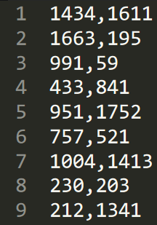
Storing the problem
/10
Cloud of point
Every point are connecting to each others
But no representation of the links
Stored in CSV file
Subject presentation
Task repartition
Algorithm – Simplification
Algorithm – Cluster / Greedy
Statistics
- Which - How
Statistics - Results
Results
Graph Generation

Slide 6
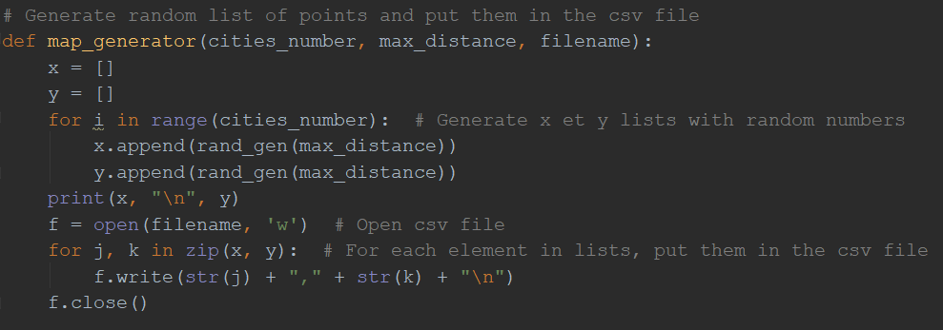
Generate Graphs
/10
MapGenerator.py
Simple code that put in the list X and Y randomized number
This create points with random coordinates
Write them in CSV file
Subject presentation
Task repartition
Algorithm – Simplification
Algorithm – Cluster / Greedy
Statistics
- Which - How
Statistics - Results
Results
Graph Generation

Slide 7
Algorithm Simplification
/10
VRP
Into : Multiple + TSP
Subject presentation
Task repartition
Algorithm – Simplification
Algorithm – Cluster / Greedy
Statistics
- Which - How
Statistics - Results
Results
Graph Generation

Slide 8
Algorithm Cluster / Greedy
/10
Subject presentation
Task repartition
Algorithm – Simplification
Algorithm – Cluster / Greedy
Statistics
- Which - How
Statistics - Results
Results
Graph Generation

Slide 9
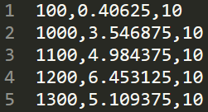
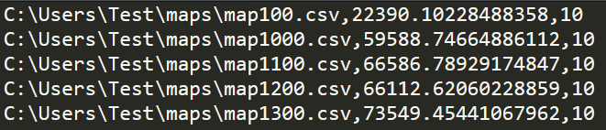
Statistics What we’ve done
/10
Statistics :
Mean, median, range, first quartile, third quartile, variance
Cloud of points
Regression line and its coefficients
Generated a lot of statistics with the scalability script
Stored the statistics in csv file :
stats.csv result.csv
Subject presentation
Task repartition
Algorithm – Simplification
Algorithm – Cluster / Greedy
Statistics
- Which - How
Statistics - Results
Results
Graph Generation

Slide 10
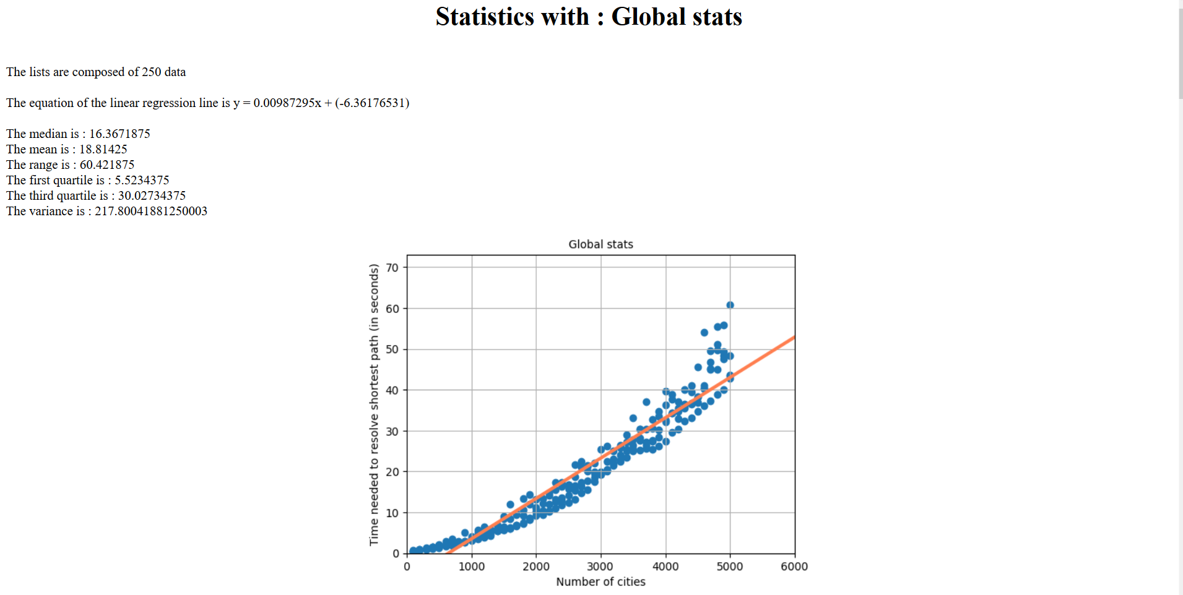
Statistics What does it looks like ?
/10
Subject presentation
Task repartition
Algorithm – Simplification
Algorithm – Cluster / Greedy
Statistics
- Which - How
Statistics - Results
Results
Graph Generation

Slide 11
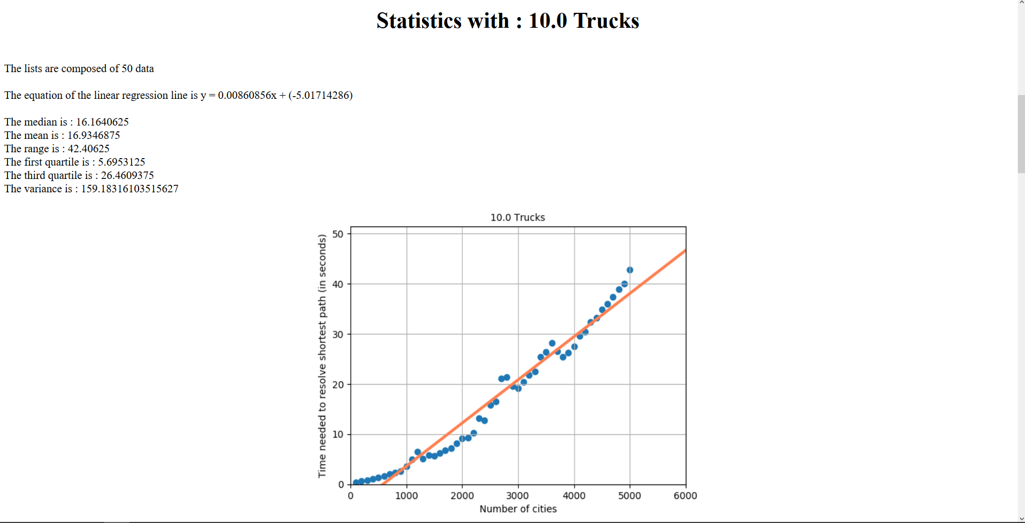
Statistics What does it looks like ?
/10
Subject presentation
Task repartition
Algorithm – Simplification
Algorithm – Cluster / Greedy
Statistics
- Which - How
Statistics - Results
Results
Graph Generation

Slide 12
Statistics Results
/10
Generate a report in HTML with all the statistics
One part for the global statistics
One part for each number of trucks used (ex: 10, 20,30 ….)
For the same cities number more there are trucks (clusters), more resolution time increases
Increasing the distance between cities has no impact or little impact on the resolution time.
With equal number of trucks, the more cities there are, the more the resolution time increases
The resolution time can vary enormously between several graphs of the same parameters (number of cities and distances).
Subject presentation
Task repartition
Algorithm – Simplification
Algorithm – Cluster / Greedy
Statistics
- Which - How
Statistics - Results
Results
Graph Generation

Slide 13
Results
/10
Subject presentation
Task repartition
Algorithm – Simplification
Algorithm – Cluster / Greedy
Statistics
- Which - How
Statistics - Results
Results
Graph Generation

Slide 14
Conclusion
/10
Subject presentation
Task repartition
Algorithm – Simplification
Algorithm – Cluster / Greedy
Statistics
- Which - How
Statistics - Results
Results
Graph Generation

